Slide 1
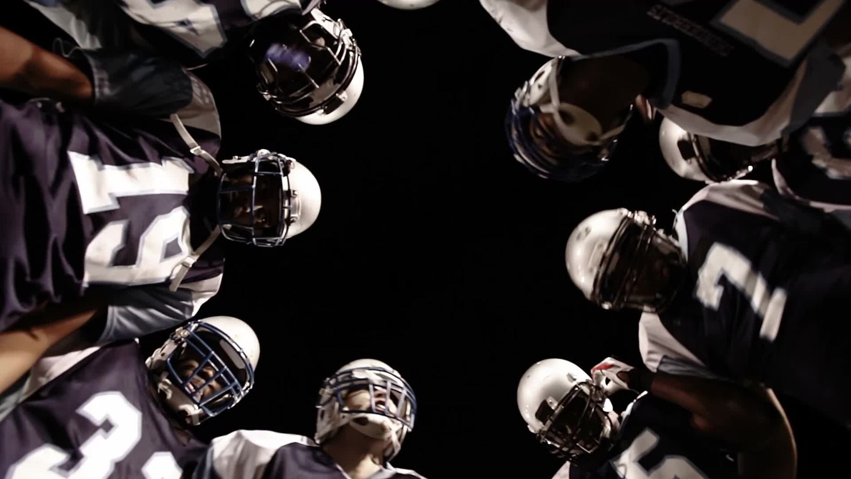
Data Analytics: How Can it Impact the NFL?
Alec Peffer
Kiana Pedro Hatter
Christopher Melkonian
Josh Conley

Slide 2


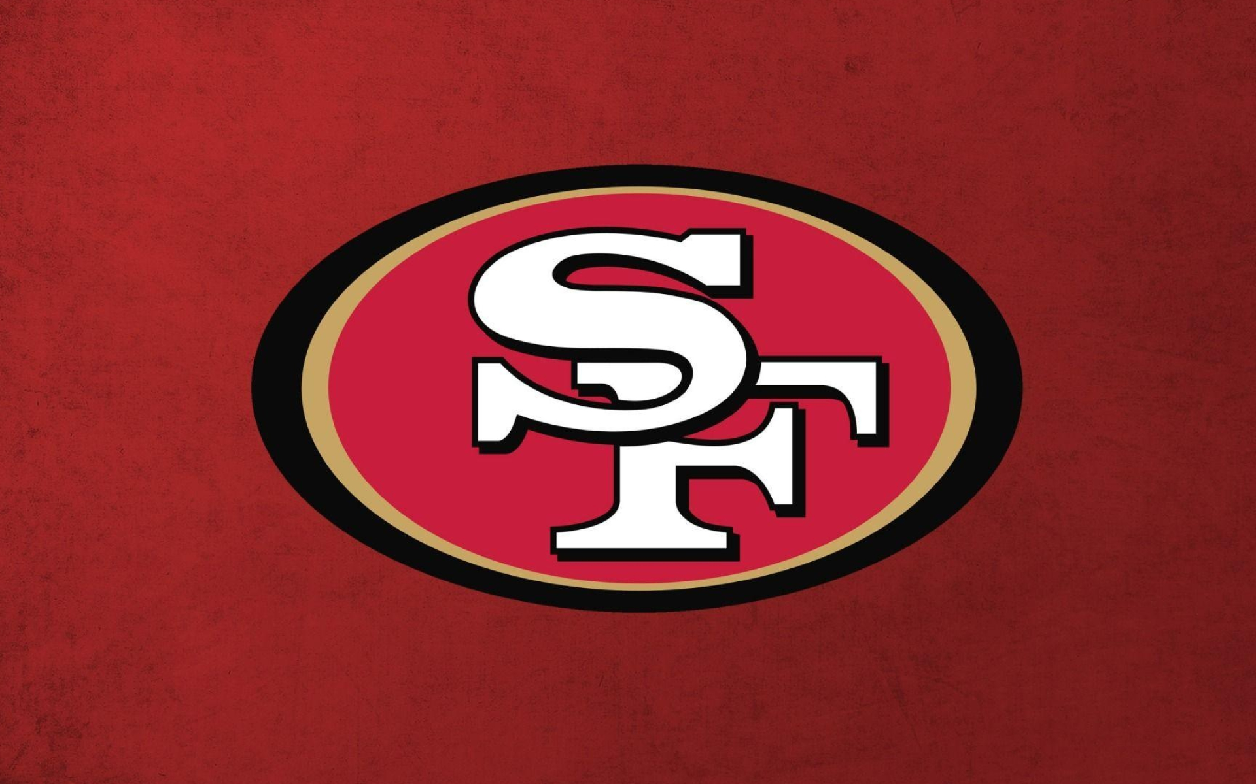

Introduction
Focus on 4 NFL teams
Arizona Cardinals
LA/St. Louis Rams
Seattle Seahawks
San Fracisco 49ers
Based on historical data between 2000-2019

Slide 3

Goals/Problem Description
Main Goal
Can forecasting be used to find a correlation between team success and fan engagement?
Sub-Goals
Can NFL franchises use forecasting techniques to determine future home attendance trends?
How can franchises try to improve rosters to increase attendance trends?
Can forecasting determine what marketing moves to make to increase fan attendance and engagement?

Slide 4
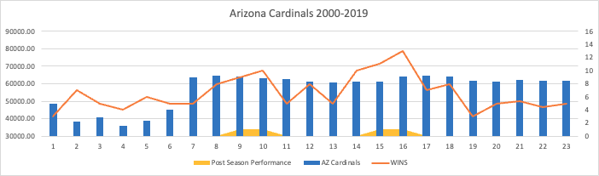
AZ Cardinals Data
Average Home Attendance (2000-2019)
56,322 fans
Highest Attendance Year
2016
Lowest Attendance Year
2003
Average Wins Per Season (2000-2019)
6.9
Playoff Appearances
4

Slide 5
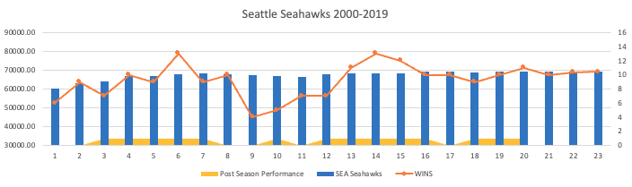
SEA Seahawks Data
Average Home Attendance (2000-2019)
67,187 fans
Highest Attendance Year
2016
Lowest Attendance Year
2000
Average Wins Per Season (2000-2019)
9.1
Playoff Appearances
14

Slide 6
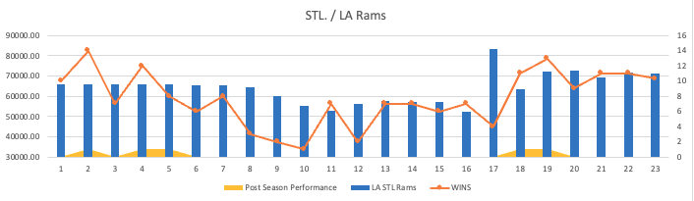
LA/STL Rams Data
Average Home Attendance (2000-2019)
63,279 fans
Highest Attendance Year
2016
Lowest Attendance Year
2015
Average Wins Per Season (2000-2019)
7.2
Playoff Appearances
5

Slide 7
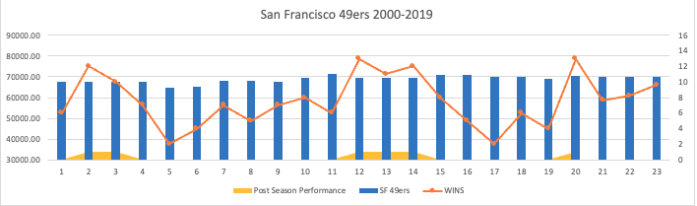
SF 49ers Data
Average Home Attendance (2000-2019)
68,805 fans
Highest Attendance Year
2010
Lowest Attendance Year
2004
Average Wins Per Season (2000-2019)
7.4
Playoff Appearances
6

Slide 8
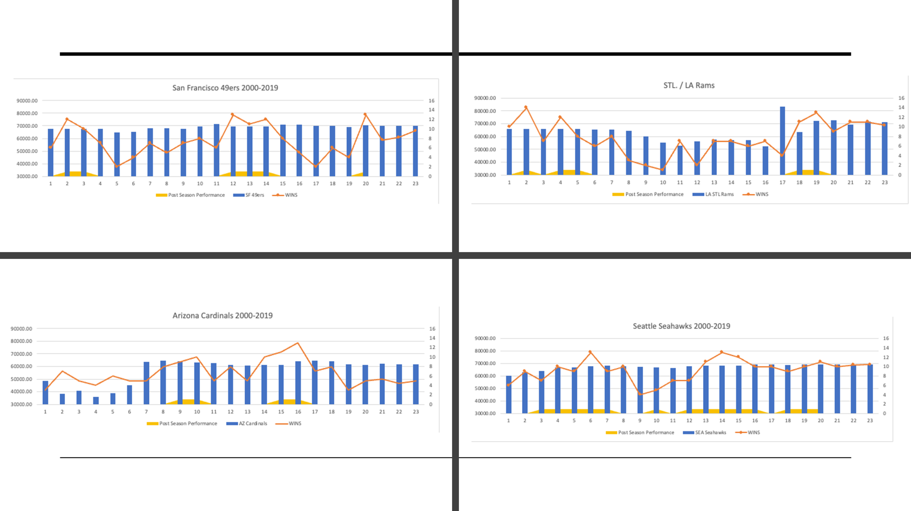

Slide 9
Is the future bright for these teams?
Based on NAÏVE and 3 season moving average forecasting for each team:
AZ Cardinals: Despite lower success between 2016-2019, fans are consistently showing up for their team.
SEA Seahawks: One thing is for sure, Seahawks fans show up. They have high attendance numbers over the 19-year span with very little movement.
LA Rams: The Rams went through an up and down phase as they moved from St. Louis to LA in 2016.
SF 49ers: The 49ers have a strong fan base. Over the data span of years, this team has had an average attendance over 65,000 throughout.

Slide 10
How can teams improve fan engagement
Offer ticket or food promotions to bring fans to the stadium
Especially against lower caliber teams
Upgrade stadium and seat comfort
Improve transportation options for fans to get to stadium
Increase stadium capacity
Improve team
Add star worthy players to increase fan excitement

Slide 11
Final Thoughts
There is a clear correlation between fan engagement and team success.
Forecasting can be used to demonstrate future trends, however, in the end, it is how well the team performs that will determine how succesful the franchise is as a whole.
Marketing and promotional offers are essential if a franchise is struggling to win

